Slide 1

GPU-accelerated
Cardiac Electrophysiological Simulation
CIS 565: GPU Programming and Architecture, Final Project Proposal
Zirui Zang (zzang@seas.upenn.edu) 20211025

Slide 2
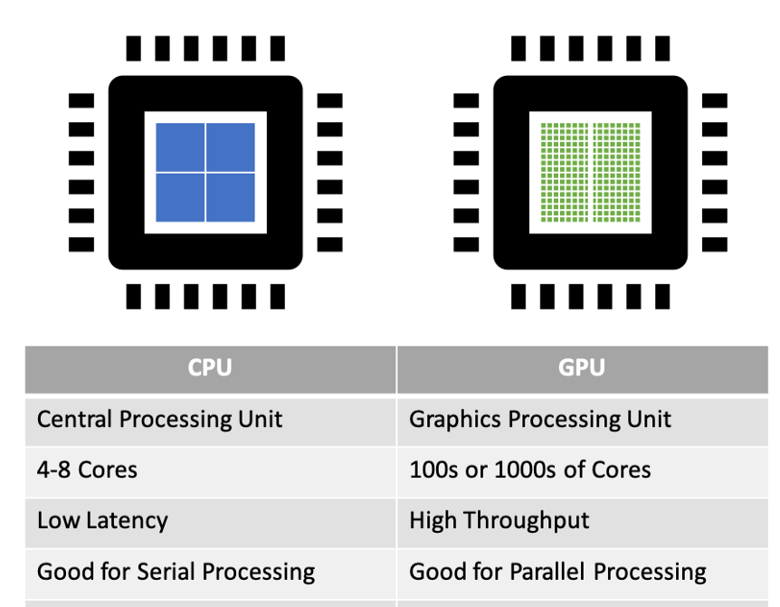
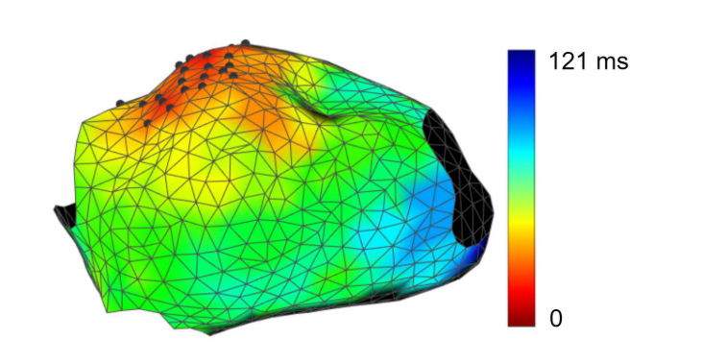
Summary
Graphics Processing Unit (GPU) is widely used in various industries for its powerful performance in parallel computing tasks.
We are developing a GPU-based cardiac electrophysiological simulator that can model the transmission of electrical signal inside a heart, using the CUDA API developed by Nvidia.
The accelerated simulation can lead to much quicker parameter tuning for patient-specific cardiac modeling during treatment of atrial fibrillations (AF) patients.
We will optimize and test deploy the simulator in a server platform, a workstation platform and an embedded platform.
CPU and GPU
Cardiac Electrophysiological Simulation

Slide 3
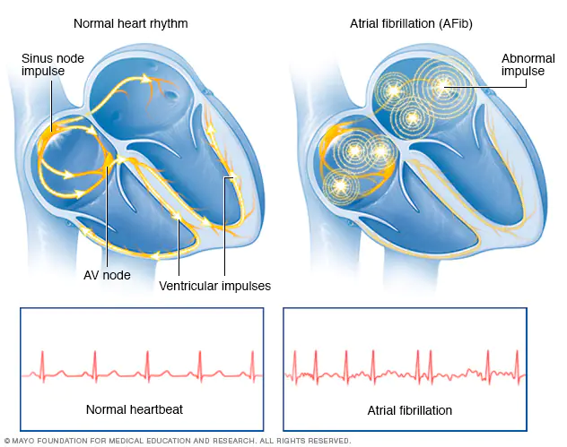
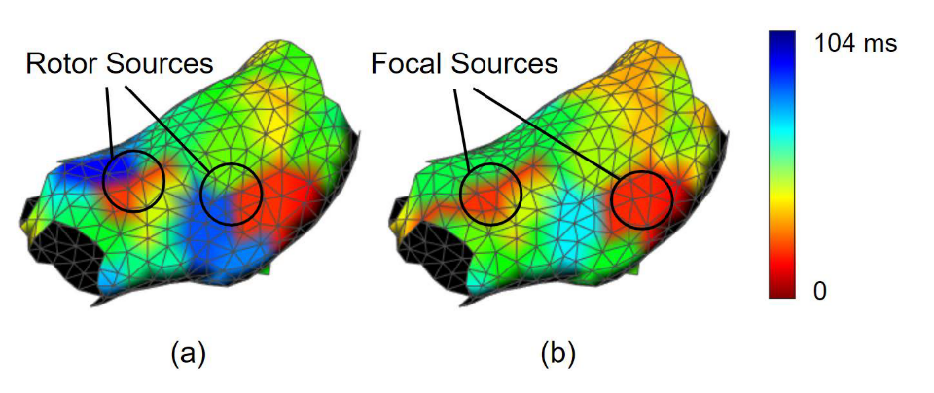
Background
In Atrial Fibrillation (AF), the heart's upper chambers beat chaotically and irregularly, out of sync with the lower chambers of the heart.
Catheter ablation is a procedure that uses radiofrequency energy to destroy a small area of heart tissue to restore regular rhythm.
However, real patients’ hearts can be complex and finding sources of irregular beating is very difficult. One approach is trying to use electrophysiological modeling to guide the doctors’ search.
Atrial Fibrillation (AF)
Finding Potential Source Locations w/ Cardiac Modeling

Slide 4
Project Structure
Preprocessed Data
Data Handler
Compute Kernels
Visualizer
Output Data
The preprocessed patient heart geometry and parameters need to be output from the current Matlab environment and imported into the C++ environment. This is a non-trivial work because there are a lot of parameters needed to be handled efficiently.
Compute Kernels will take in the parameter and have functions to solve the ODEs and PDEs associated with the Mitchell-Schaeffer model using the Euler’s method.
A visualizer will visualize the output from the model.

Slide 5
Simulation Algorithm
Document

Slide 6
Planned Performance Analysis & Deployments
We will analyze three different versions of compute kernels and compare with the reference Matlab version:
CPU version, based on C++ Eigen library
GPU naive version
GPU optimized version, with expected memory and other optimizations.
We will deploy the simulator in three different platforms:
Server platform w/ RTX A5000 GPU (x64 Linux compile)
Workstation platform w/ RTX 2070s GPU (x64 Windows compile)
Embedded platform w/ Nvidia Jetson Xavier NX (Arm Linux compile)

Slide 7
References
https://towardsdatascience.com/parallel-computing-upgrade-your-data-science-with-a-gpu-bba1cc007c24
https://www.mayoclinic.org/diseases-conditions/atrial-fibrillation/symptoms-causes/syc-20350624
https://www.heart.org/en/health-topics/arrhythmia/prevention--treatment-of-arrhythmia/ablation-for-arrhythmias
J. He, A. Pertsov, S. Dixit, K. Walsh, E. Toolan, and R. Mangharam, “Patient-specific heart model towards atrial fibrillation,” in ICCPS 2021 - Proceedings of the 2021 ACM/IEEE 12th International Conference on Cyber-Physical Systems (with CPS-IoT Week 2021), May 2021, pp. 33–43, doi: 10.1145/3450267.3450532.

